Slide 1
Hardware Connections
Using Tinkercad software we implement hardware connections.

Slide 2
Components
Arduino UNO R3
Potentiometer [instead PH sensor]
Temperature Sensor[TMP36]
Turbidity Sensor
LED [Light Emitted Diode]
LCD [Liquid Crystal Display]
Resistor
Connecting wires
DC Motor

Slide 3
Basic Steps to design Aqua management system
Sensor Selection
Circuit Connections
Power Supply
Arduino Programming
Display or User interface
Maintenance
Protection(sensor)
Installing and Testing

Slide 4
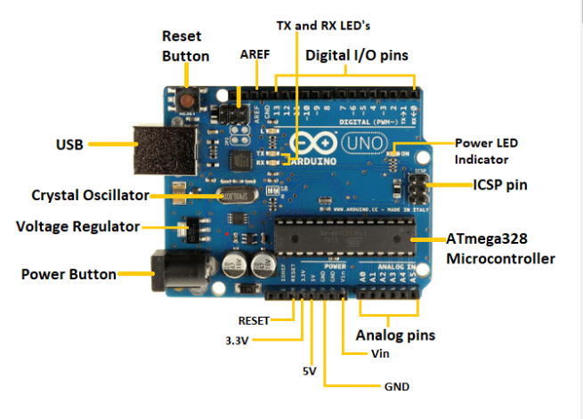
Arduino UNO
Arduino UNO is a Standard board of Arduino.Uno means ‘one’ in Italian.
It consists:
ATmega328P
Digital I/O pins [14 digital pins]
Analog pins [6 input pins]
USB connector
Power jack
ICSP(In-circuit Serial Programming) header
Power and Reset Button

Slide 5
Tinkercad Software
Tinkercad is a Software which is used to runs the 3D modelling programs in a online web browser.
It’s a free-of-charge.
It is founded by kai Backman who is the former Google engineer and Mikko Mononen.
Especially the design of physical items, accessible to the general Public.
We can make our designs as per our project related requirements.

Slide 6
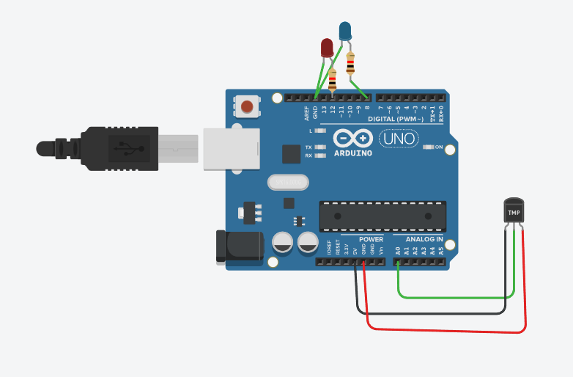
Connecting Temperature Sensor with Arduino Board

Slide 7
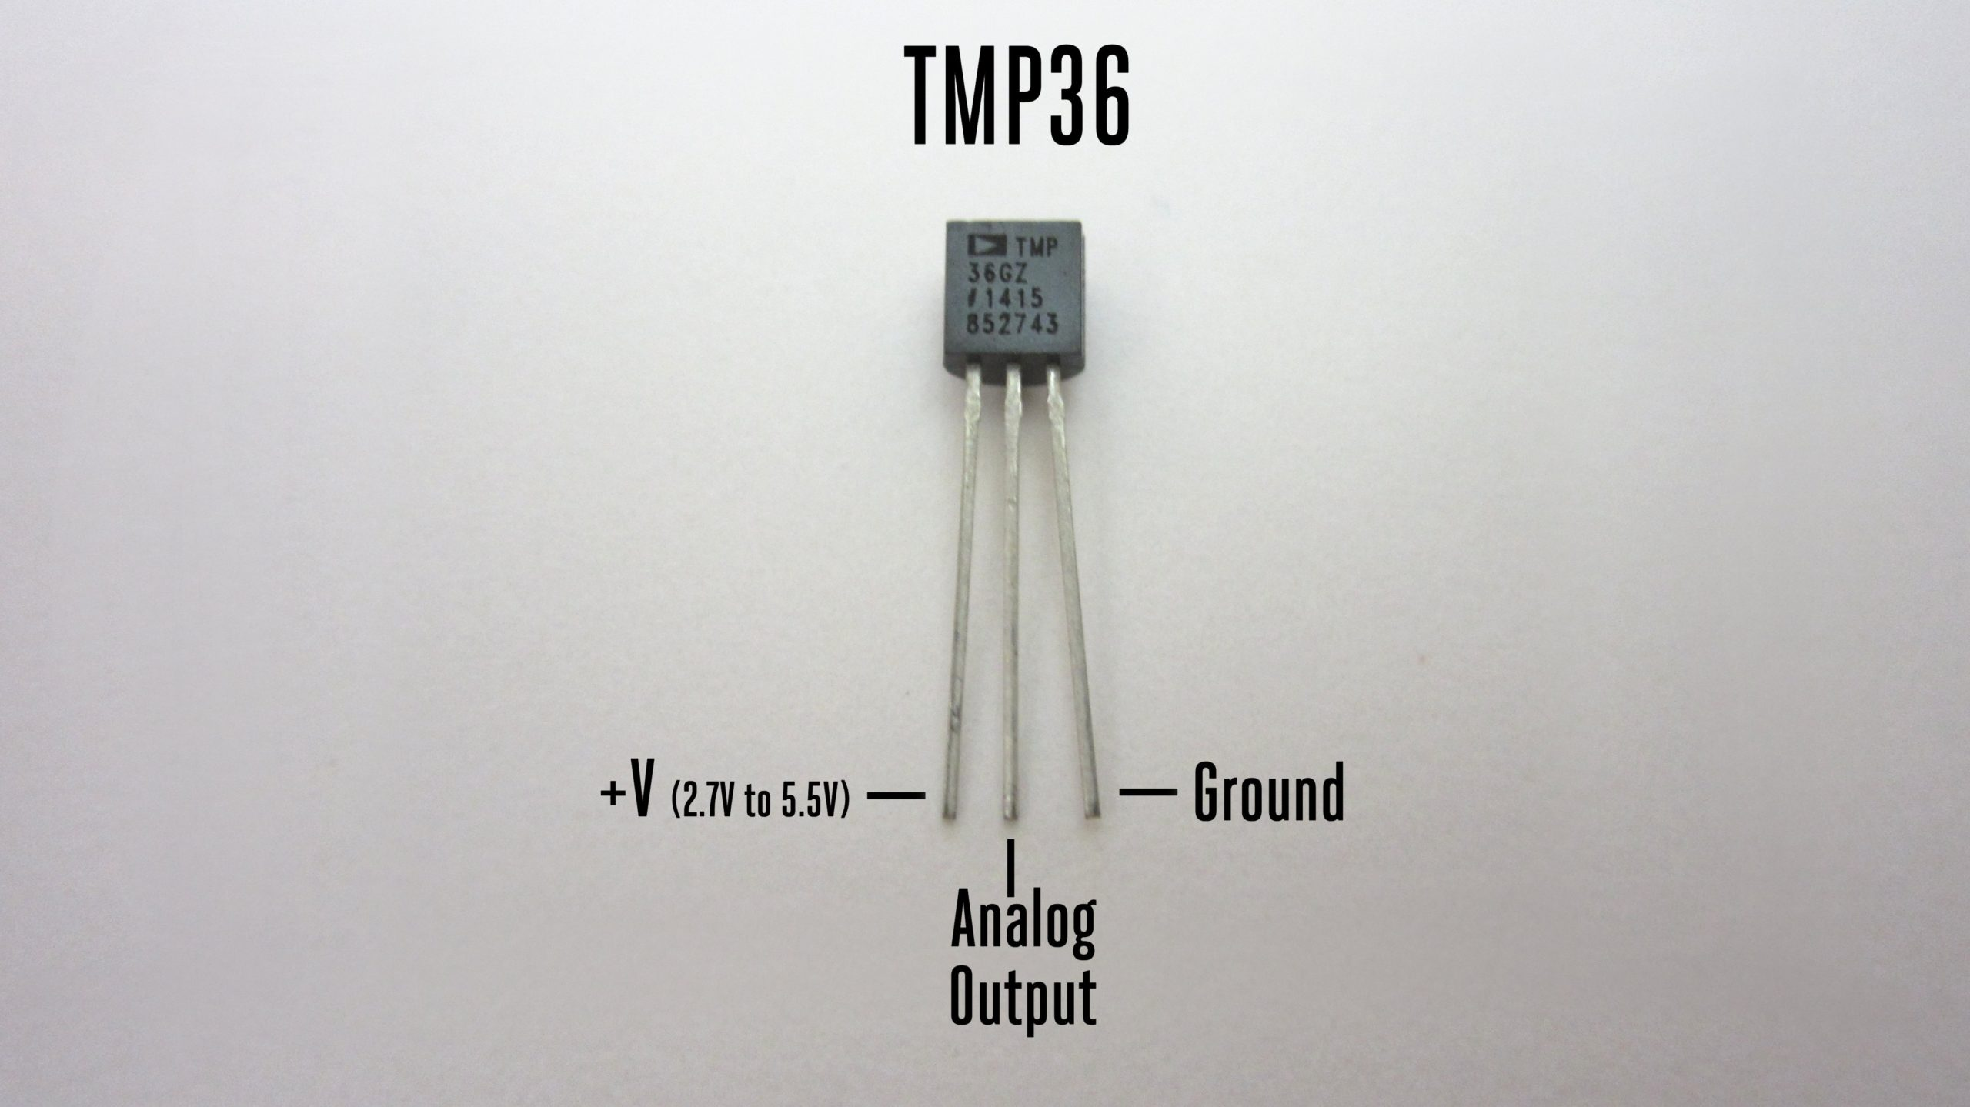
The Circuit Connetions:
The Temperature Sensor having 3 inputs
Analog pin(A0) connected to the temperature sensor(Vout)
Power terminal is connected to the 5V
Connected to Ground
There are 2 LEDs are connected to digital pins (output)
Whenever the connections are completed then we can write the code as per our conditions.
Condition:1 If the temperature level is high(>30) then the Red LED is glow
Condition:2 If the temperature level is low(<25) then the Blue LED is glow

Slide 8
Working Steps:
1.Read an Analog input value(A0)
2.Initialize serial communication
Serial.begin(value)
3.Read analog value from the temperature sensor
sensorValue = analogRead(analogPin);
4.Convert analog value to voltage (assuming 5V reference)
voltage = sensorValue * (6.0 / 1023.0);
5.Convert voltage to temperature in degrees Celsius
temperature = (voltage - 0.5) * 100;

Slide 9
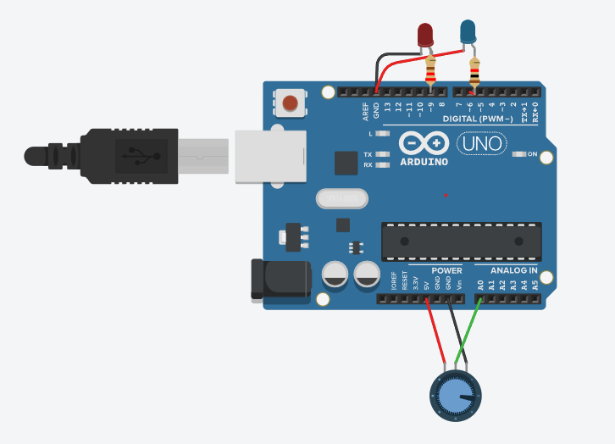
Connecting Potentiometer with Arduino Board

Slide 10
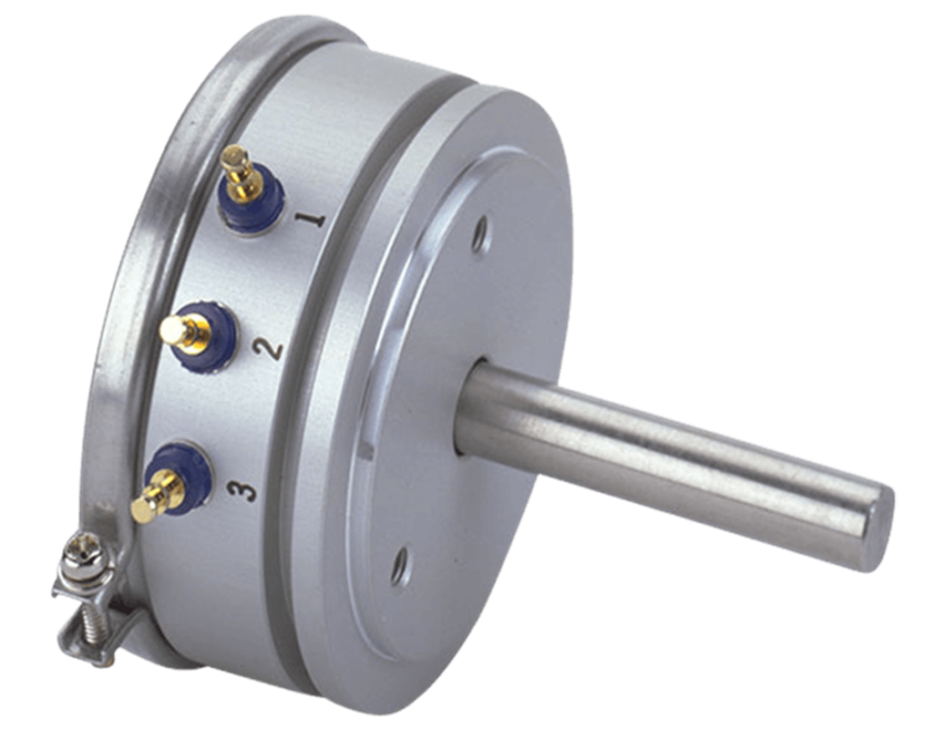
The Circuit Connetions:
Potentiometer connected to analog pin 0.
Center pin of the potentiometer goes to the analog pin.
Side pins of the potentiometer go to +5V and ground
LEDs connected from digital pin 9,6 to ground
Working Steps:
1. Reads an analog input pin and maps the result to a range from 0 to 255
outputValue = map(sensorValue, 0, 1023, 0, 255);
2. Uses the result to set the pulsewidth modulation (PWM) of an output pin.
3. Also prints the results to the serial monitor.

Slide 11
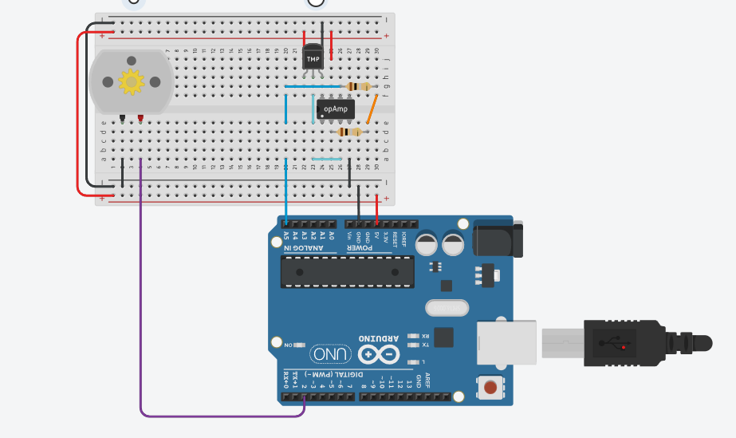
Dissolved Oxygen Sensor Circuit

Slide 12
The Circuit Connetions:
1. Power Supply Connections:
Connect the VCC pin of the dissolved oxygen sensor to the 5V pin on the Arduino.
Connect the GND pin of the dissolved oxygen sensor to the GND pin on the Arduin
2. Serial Communication Connections:
Connect the TX pin of the dissolved oxygen sensor to a digital pin on the Arduino (e.g., pin 2 or any other available digital pin).
Connect the RX pin of the dissolved oxygen sensor to a digital pin on the Arduino (e.g., pin 3 or any other available digital pin).
3. Analog Output Connection (Optional):
Some dissolved oxygen sensors provide an analog output. If your sensor has an analog output, you can connect it to an analog input pin on the Arduino if you want to measure the analog value as well.

Slide 13
Working Steps:
1. Initialize Current O2 level and Wanted O2 level as zero
Current_O2=0;
Wanted_O2=0;
2. Read an Analog input pin(A5)
3. Compare the Current O2 level and Wanted O2 level
Condition: if currentO2Level < wanted02Level then DC Motor ON

Slide 14
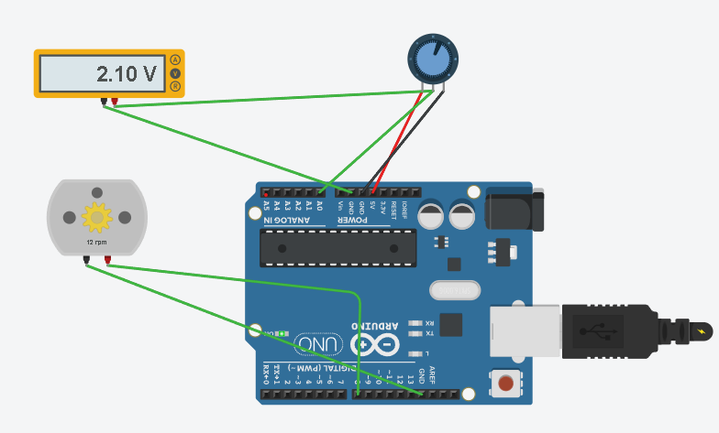
Turbidity Sensor Circuit:

Slide 15
The Circuit Connetions:
1. Power Supply Connections:
Connect the VCC pin of the turbidity sensor to the 5V pin on the Arduino.
Connect the GND pin of the turbidity sensor to the GND pin on the Arduino.
2. Analog Output Connection:
Connect the analog output pin of the turbidity sensor to an analog input pin on the Arduino (e.g., A0 or any other available analog input pin).

Slide 16
Working Steps:
Read an Analog input pin(A0) to y
Declare the varibles U,a, b, c with their calibrating value
U=((5*y)/1023);
a = (5742.3 * U);
b = (1120.4 * (U * U));
c = 4352.9;
3. Convert the volts into Turbidity value by using this formula
Turbidity = (a - (b + c));
4. Condition: If Turbidity value > some_value_given then automatic pipes open water flows out and pump is ON (for new Water)

Slide 17
THANK YOU

